Slide 1
Sentiment Analysis on YouTube Trending Video
- Ankit Modi

Slide 2
Table of Content
Introduction
About Dataset
Current State of Art
Methods used in sentiment analysis
Model Training and Evaluation
Model Testing
Conclusion

Slide 3
Introduction

Slide 4
Overview
Sentiment analysis involves determining the sentiment
BERT model is used in various natural language processing (NLP) tasks, including sentiment analysis
Sentiment analysis on YouTube video titles plays a pivotal role in determining the appropriateness of content

Slide 5
About Dataset

Slide 6
About Dataset
Available on Kaggle- https://www.kaggle.com/datasets/rsrishav/youtube-trending-video-dataset
Daily record of the top trending YouTubevideos, updated regularly
Data of 11 countries
Perform sentiment classification to predict sentiment (positive/ negative/ neutral)
11 JSON files - retrieve the categories

Slide 7
Current State of Art

Slide 8
Current State of the Art
Limited focus on sentiment analysis or natural language processing (NLP)
Previously related work in this area:
1) Sentiment Analysis for Youtube Videos with User Comments: Review
https://ieeexplore.ieee.org/abstract/document/9396049
Primarily concentrates on sentiment analysis within the United States, covering English and Indonesian languages.
2) Discovering popular and persistent tags from YouTube trending video big dataset
https://link.springer.com/article/10.1007/s11042-023-16019-z
Sentiment analysis on YouTube trending videos in the United States for the year 2021

Slide 9
What Is New
This project aims to improve YouTube sentiment analysis by integrating -
more data
data of many years (from last couple of years to the data which is more recent)
data from 11 countries varying in languages of video titles/ tags/ comments

Slide 10
Methods Used in Sentiment Analysis

Slide 11
Methods Used in Sentiment Analysis
Data understanding
Data Preprocessing
Language Detection
Sentiment Classification

Slide 12
Data Understanding
11 .csv files, each representing a country’s daily trending videos
Spanning from 08/06/2020 to 10/30/2023
One .csv file contains over 235,000 records
Utilizing pathlib library, data is consolidated into single dataframe
Size of dataset is 2,552,859 rows and 17 columns

Slide 13
Data Preprocessing
‘days_of_trending’ column is computed from ‘trending_date’ and ‘publish_date’
Sort days of trending column in descending order, and deleted the duplicate rows
.json files are incorporated into dataset and mapped the category with categoryId

Slide 14
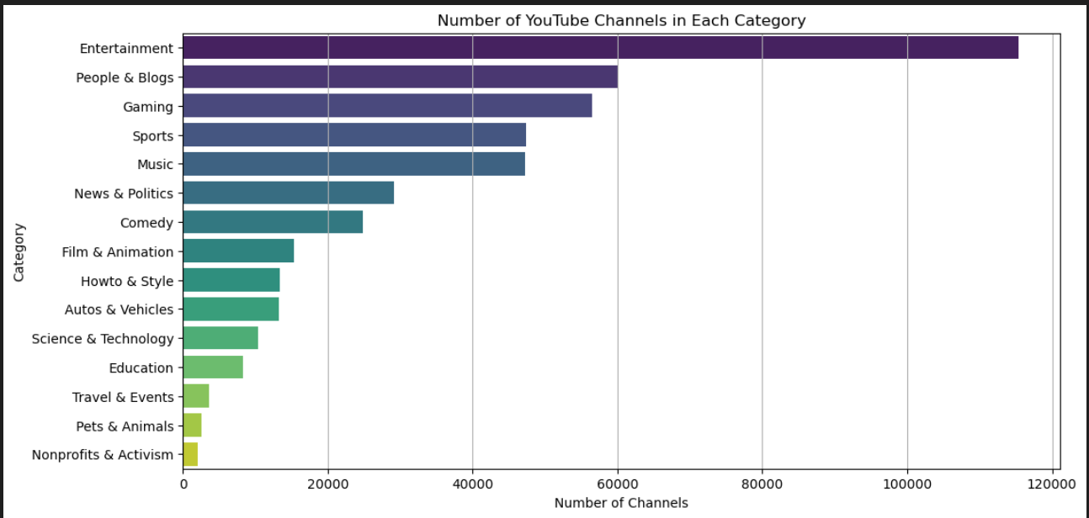
EDA on Category: YouTube Channels in Each Category

Slide 15
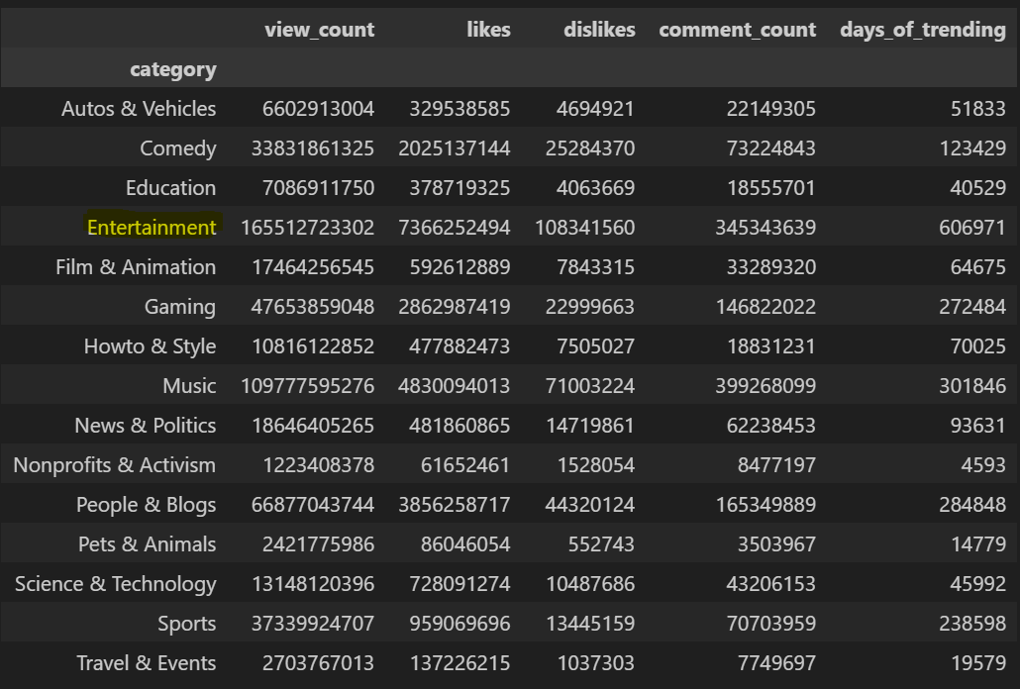
EDA on Category: Category Wise Analysis

Slide 16
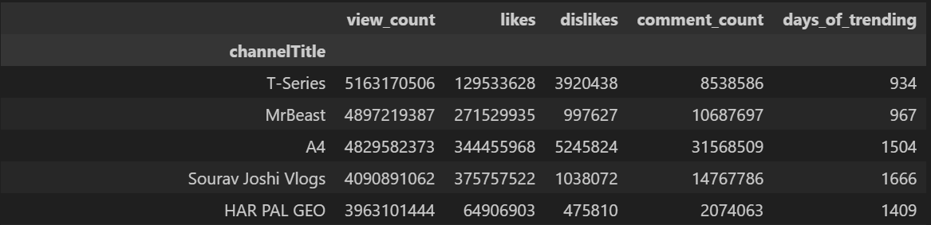
EDA on ChannelTitle: Top 5 Channels With Highest Views

Slide 17
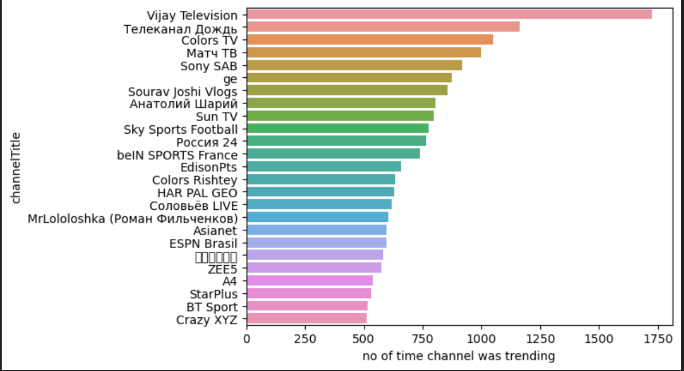
EDA on Category: Number of Time Channel is Trending

Slide 18
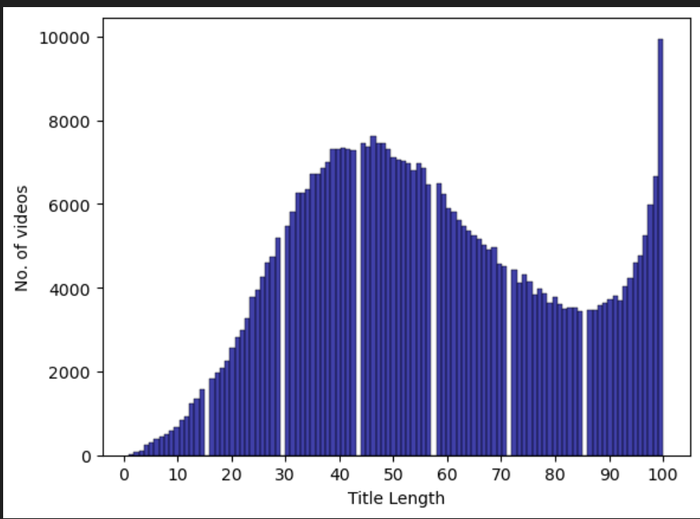
EDA on Video Title: Histogram of Video Title and Title Length

Slide 19
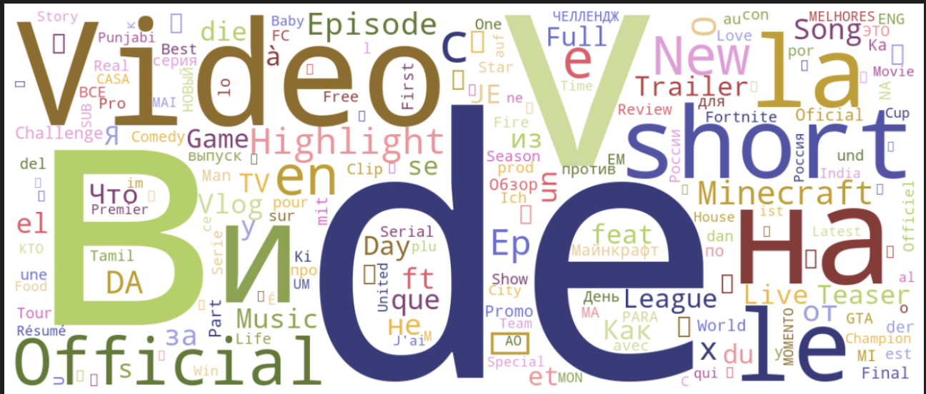
WordCloud

Slide 20
More Data Preprocessing
Lowercase all titles
Remove punctuation
Clean titles by eliminating non-alphanumeric tokens, stopwords, and any entries resembling monetary amounts
Data from the United States, France, Mexico, and Germany is selected

Slide 21
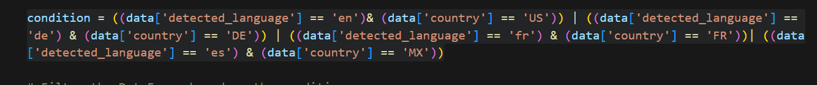
Language Detection
Langid library is used to detect the language of video title
Kept only those data where the video title’s detected language is English, French, German, and Spanish
Make data more robust, condition was applied that matches detected language and country column
For example, if detected language is French, then country must be France
Now, the data is streamlined to 87,428 rows, facilitating more focused and efficient analysis compared to the initial expansive dataset. 67,000 rows are used as train data and remaining as test data
Data I got here is considered as the original data (combination of training and testing data) on which I will perform sentiment analysis

Slide 22
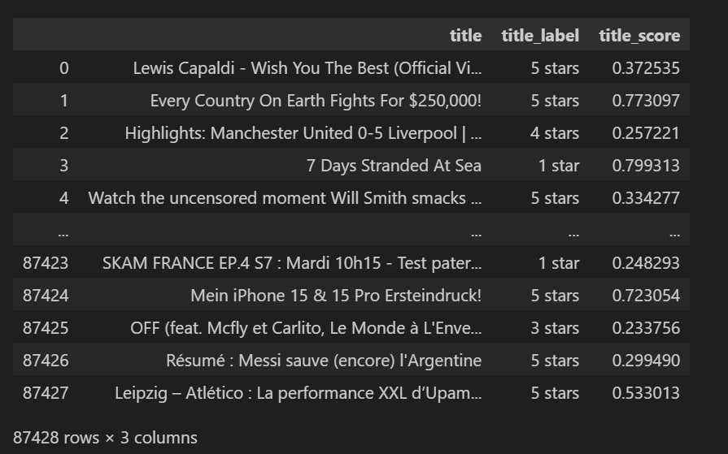
Final Dataset

Slide 23
Sentiment Classification
Convert title_label into sentiment and have values in positive, negative, and neutral
BERT model (nlptown/bert-base-multilingual-uncased-sentiment) is used with sentiment analysis pipeline
Classify sentiments in YouTube video titles
For each title, the model outputs a sentiment label and a corresponding confidence score
Titles are tokenized using TensorFlow Tokenizer and sequences are padded to a fixed length using TensorFlow’s pad sequences function for both- train and test dataset

Slide 24
Model Training and Evaluation

Slide 25
Model Training and Evaluation
Pre-trained BERT model as the initial layer, with its layers frozen
Followed by 2 additional layers to classify sentiments into three categories: positive, negative, and neutral
dataset is split into training and validation sets using a test size of 20%
Stochastic Gradient Descent (SGD) optimizer is utilized to train the sentiment analysis model along with sparse categorical cross-entropy loss function and accuracy as metric
Model is trained for a total of five epochs, with each epoch comprising batches of 32 samples
Callback is used to save the best model

Slide 26
Model Testing

Slide 27
Model Testing
‘best model’ is loaded using the ’load model’ function
The model is then evaluated on the test set using the ‘evaluate’ method
Model got the accuracy of around 65%

Slide 28
Conclusion

Slide 29
Conclusion
BERT-based sentiment analysis mode enhances the project’s analytical capabilities
Sentiment classification model is primed to discern positive, negative, and neutral sentiments in video titles across multiple languages
Provide more holistic understanding of sentiment patterns in the dynamic realm of YouTube content

Slide 30
Thank You!

